Slide 1
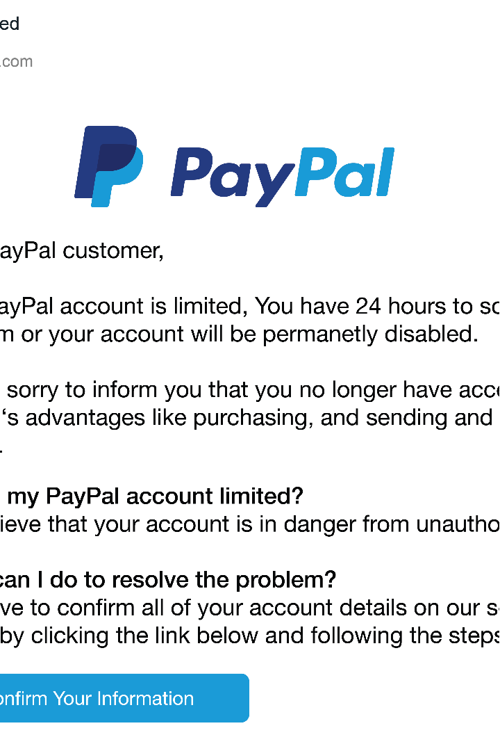
Introduction to Phishing Attacks
Phishing attacks are a type of cybercrime that use deceptive tactics to trick people into revealing sensitive information, such as login credentials or financial information. These attacks often come in the form of fake emails, text messages, or social media posts that appear to be from legitimate organizations. By understanding how phishing attacks work and learning to recognize the warning signs, you can protect yourself and your organization from becoming a victim.
by Ruchitha Grandhi

Slide 2
Understanding Phishing Tactics
Impersonation
Urgency and Fear
Phishers often try to impersonate well-known companies, government agencies, or other trusted organizations to make their messages seem more credible. They may use logos, branding, and even domain names that look similar to the real thing.
Phishing messages frequently try to create a sense of urgency or fear, such as threatening account suspension or legal action, to pressure the recipient into taking immediate action without thinking it through.
Fake Offers and Rewards
Malicious Attachments and Links
Some phishing attacks offer enticing prizes, discounts, or other incentives to lure victims into providing their personal information or clicking on malicious links.
Phishers may include infected attachments or links that, when clicked, can install malware or direct the user to a fake website designed to steal their login credentials.

Slide 3
Recognizing Phishing Emails
1
Sender Email Address
2
Suspicious Requests
Carefully examine the sender's email address to see if it matches the purported organization. Phishers often use similar-looking domains or email addresses to trick you.
Beware of emails that ask you to provide sensitive information, such as login credentials, credit card numbers, or social security numbers. Legitimate organizations will not typically request this information via email.
3
Poor Grammar and Spelling
4
Generic Greetings
Phishing emails often use generic greetings like "Dear customer" or "Dear user" instead of using your name, which is a common tactic to make the message appear less personalized.
Phishing emails often contain obvious grammatical errors, misspellings, or poor formatting, which can be a red flag that the message is not from a credible source.

Slide 4
Identifying Suspicious Links and Attachments
Hover Over Links
Beware of Attachments
Use URL Shorteners with Caution
Before clicking on any links in an email, hover your mouse over them to see the actual URL. If the link looks suspicious or doesn't match the purported destination, it's likely a phishing attempt.
Avoid opening attachments from unknown or suspicious sources, as they could contain malware designed to steal your information or infect your device. If you're unsure about an attachment, contact the sender directly to verify its legitimacy.
Phishers often use URL shortening services to disguise the true destination of a link. Be wary of links that use a shortened URL, and consider expanding the link to see the full destination before clicking.

Slide 5
Protecting Yourself from Phishing Scams
1
Be Skeptical
2
Verify Legitimacy
Approach all unsolicited emails, text messages, and social media posts with a healthy dose of skepticism. If something seems too good to be true or doesn't align with your normal interactions with a company, it's likely a phishing attempt.
If you're unsure about the legitimacy of a message, contact the purported organization directly using a known, trusted method (such as their official website or customer service number) to confirm the request.
3
Use Strong Passwords
4
Enable Two-Factor Authentication
Protect your accounts with strong, unique passwords that are difficult for attackers to guess. Consider using a password manager to generate and store your passwords securely.
Whenever possible, enable two-factor authentication on your accounts to add an extra layer of security and make it more difficult for attackers to gain access, even if they obtain your password.

Slide 6
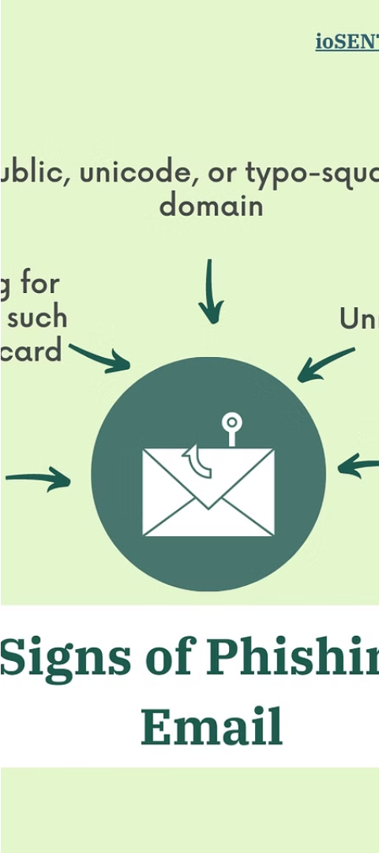
Best Practices for Handling Suspicious Emails
1
Recognize
Learn to identify the common signs of a phishing email, such as suspicious sender addresses, urgent requests, and unexpected attachments or links.
2
Report
If you suspect an email is a phishing attempt, report it to your organization's IT or security team, as well as the relevant authorities, such as the Anti-Phishing Working Group or the Federal Trade Commission.
3
Delete
Once you've reported the suspicious email, be sure to delete it from your inbox and any other folders to prevent the potential spread of malware or further attempts to steal your information.

Slide 7




Reporting Phishing Attempts
Report to IT
Report to Authorities
Forward Emails
Delete Suspicious Emails
Notify your organization's IT or security team about any suspicious emails you receive, so they can investigate and take appropriate action.
Consider reporting phishing attempts to the relevant authorities, such as the Anti-Phishing Working Group or the Federal Trade Commission, to help combat these scams.
If requested, forward any suspicious emails to the organization being impersonated, such as your bank or service provider, so they can investigate and take action.
After reporting a suspicious email, be sure to delete it from your inbox and any other folders to prevent further potential harm.

Slide 8
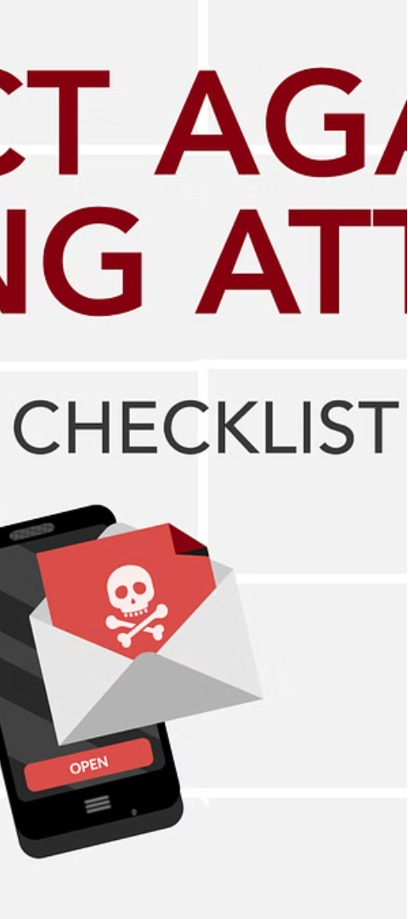



Conclusion and Key Takeaways
Stay Vigilant
Remain alert to the threat of phishing attacks and continuously educate yourself and your team on the latest tactics used by cybercriminals.
Implement Security Measures
Adopt strong security practices, such as using multi-factor authentication, regularly updating software, and implementing robust email filtering and malware protection.
Report and Respond
Promptly report any suspicious activity to the appropriate authorities and follow the recommended steps to mitigate the impact of a potential phishing attack.

